Slide 1


GRAAHO
AI
Solutions:
AI
Are you ready for the revolution that is already here?
.
USA: 12110 Sunset Hills Road
Suite 600, Reston VA 20190
Bangladesh: Road 6/A, Ave 8
House 1087 Mirpur DOHS,
Dhaka 1216
sales@graaho.com
www. graaho.com
USA: +1 703.623.0492
BD : +880 170 851 7489

Slide 2
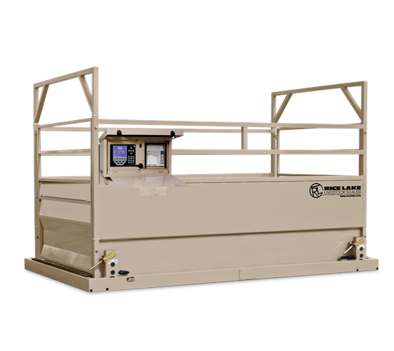
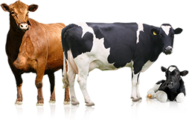
PROBLEM STATEMENT.
Weight & Breed are key drivers in livestock (i.e. cows) trading. Yet, Livestock Weight Measurement is a key challenge during production and procurement because available industrial livestock scales are simply:
Bulky
Expensive
Not Easily Portable
A typical agricultural scale: 13’ x 8’; 15000 LBS

Slide 3
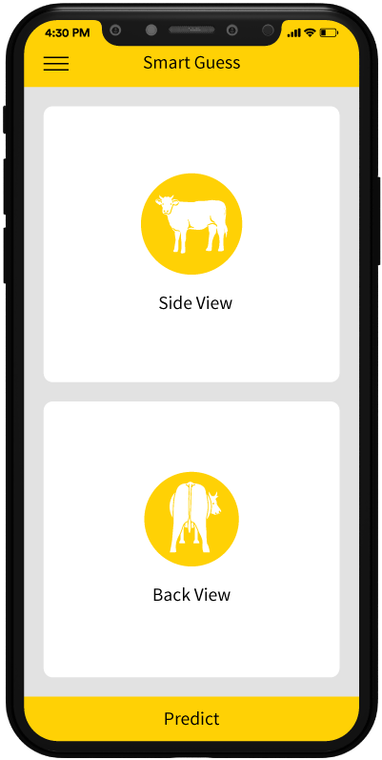
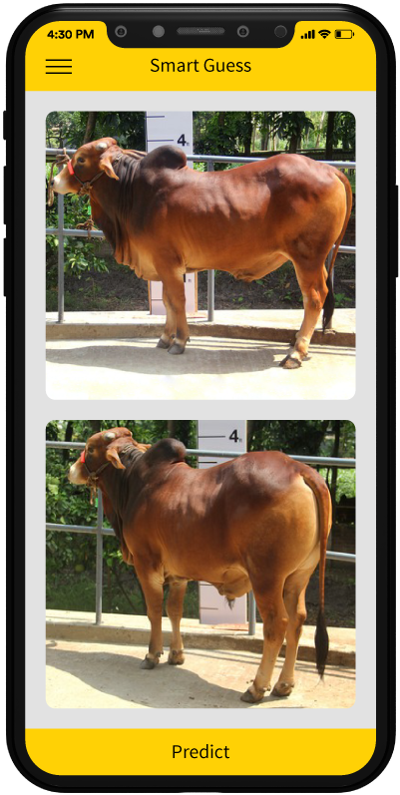
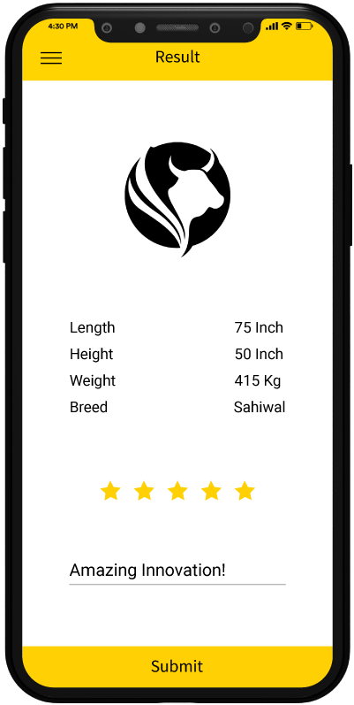
OUR SOLUTION.
A Mobile Computer Vision Solution that will provide accurate Breed and Weight Information in 3 simple steps:
“The concept of Machine Learning ushered in an era in which instead of telling computers what to look for in images and videos, we can design algorithms that allows computers to learn how to recognize objects in images by itself, just like a human learn to recognize objects by exploring them with their own eyes…”
Take a picture
Upload image
Get Results
Take a picture with your mobile phone
Upload image via an online web API
Get the info you need to make better decision

Slide 4


Slide 5

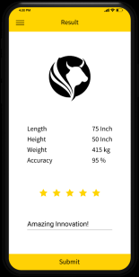
VALUE PROPOSITION.
AI can augment and scale human expertise and aid solving real-world challenges. Much of the recent progress in AI has relied on data-driven techniques like deep learning and artificial neural networks. Given sufficiently large labeled training data sets and enough computation, these approaches can achieve unprecedented results.
Increase Speed and Accuracy
Low Cost & Portability
Bulky Weighing scales are not required
Reduce time spent on weighing leading to productivity gain
Low cost device that is easily portable
Augment traders/livestock buyers existing knowhow to make better decisions
Reduce Weight tampering and misleading breed information
Maximize Output
vs.
Increase overall yield by reducing weighing error
Increase profitability due to reduced error in buying decisions

Slide 6





MARKET & END USERS.
FARMERS
INDUSTRIAL BUTCHER SHOPS & MEAT PROCESSORS
LIVESTOCK TRADERS
A low cost alternative to expensive weighing scale for farmers rearing livestock to keep track of the health of their livestock inventory.
Increased productivity and accuracy in procurement decision making for Butcher shops & Meat Processors.
Increased profitability through minimizing errors in weight estimations for spot livestock traders
VETERINARIANS
GENERAL CONSUMERS
Enable better animal care. Accurate weight estimation and breed identification are required for growth tracking and dosage estimation.
Enable better decision making for consumer looking to purchase livestock directly from the farmers or traders.

Slide 7
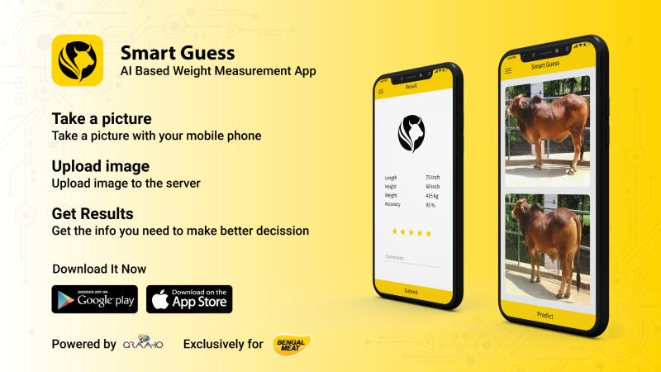
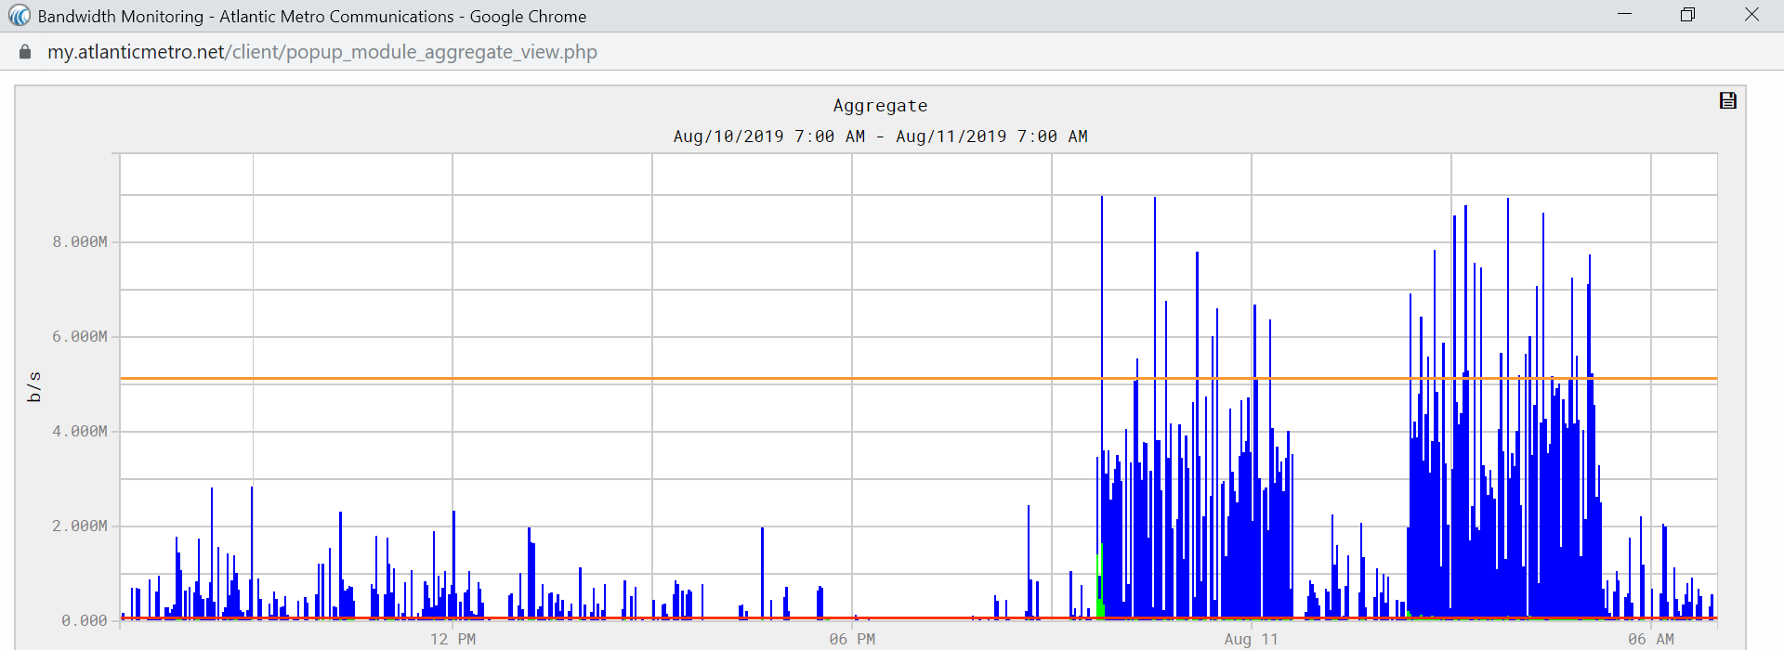
USAGE STATISTICS.
Smart Guess was launched three days before last Eid-al-Adha on August 8th 2019, and was quickly adopted by the consumers to aid in the sacrifice procurement.
496 Google Play Store downloads in just two days
Average rating of 4.40 with 80.00% of 5

Slide 8
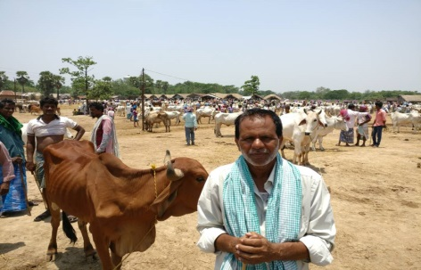




CASE STUDY.
USER STORY
RESULTS
SCALE
INCREASED PROFIT
“I want to be certain of the breed and the weight before I purchase..” Ashraf K. Livestock Trader
TECHNOLOGY STACK
Programming: Python 3.6, Tensorflow
THE CHALLENGE
Bengal Meat, one of Bangladesh’s largest livestock management and meat processing company, needed to scale its production and wanted to leverage technology to increase the accuracy of its procurement team’s livestock measurement techniques. It looked to GRAAHO for Emerging Technology expertise and device a solution.
Mobile: iOS, Android
SOLUTION
GRAAHO proposed and developed an computer vision AI solution that
Trained an algorithm to recognize livestock breed, height, weight and other vitals
Developed iOS & Android app to enable end users to feed the algorithm new livestock images to predict

Slide 9




OUR TEAM.
Our team is comprised of seasoned developers with a wide range of technical and development experiences..
MOBASSHIR BHUIYAN
ARIF HOSSEN
SATEJ SARKAR
SAIFUL ISLAM
Software Engineer
Sr. Software Engineer
Software Engineer
Software Engineer
Passionate about developing Emerging technology products, Computer vision.
Fullstack developer with focus on web and mobile development.
Full Stack developer with focus on web and mobile developer.
Full stack developer with focus on web and emerging tech development.

Slide 10

ABOUT US.
Emerging Technology Solutions to Power your Business Forward
GRAAHO is an emerging technology solutions provider with offices in Washington D.C metro area and Dhaka, Bangladesh. We serve private and public sector clients globally. At GRAAHO, we deploy disciplined approach to design, analysis, programming and project management to deliver end-to-end scalable solutions to our global manufacturing, services, retail, financial and government sector clients. At GRAAHO, we are always ready to tap into our deep domain expertise and technology prowess to help our clients deploy and scale from a simple website to more complex IoT, Big Data, AI/Machine learning and Block Chain technologies to get the most value out of their investments.

